Slide 1
DATA VALUE CHAIN

Slide 2
Definition
The data value chain describes the evolution of data from collection to analysis, dissemination, and the final impact of data on decision making.
The data value chain provides a framework through which to visualize the life cycle of data from defining a need to using them for impact.

Slide 3
Application
Generation
recording and capturing data
Collection
collecting data, validating, and storing it
Analytics
processing and analyzing the data to generate value
Exchange
putting the outputs to use

Slide 4
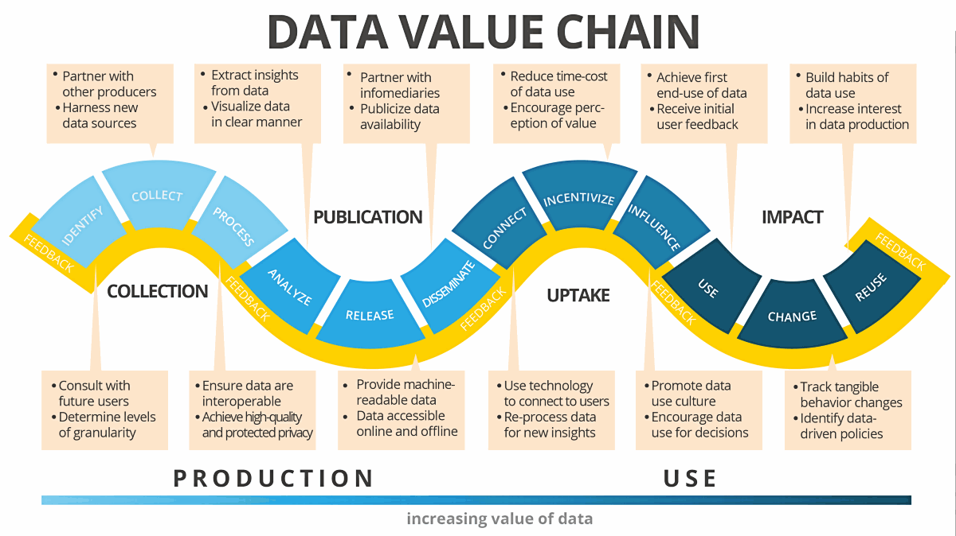
Schematics 1

Slide 5
Collection – identifying, collecting, processing data
Publication – publishing, disseminating, analyzing data
Uptake – connecting, incentivizing, influencing
Impact – using, changing, reusing

Slide 6
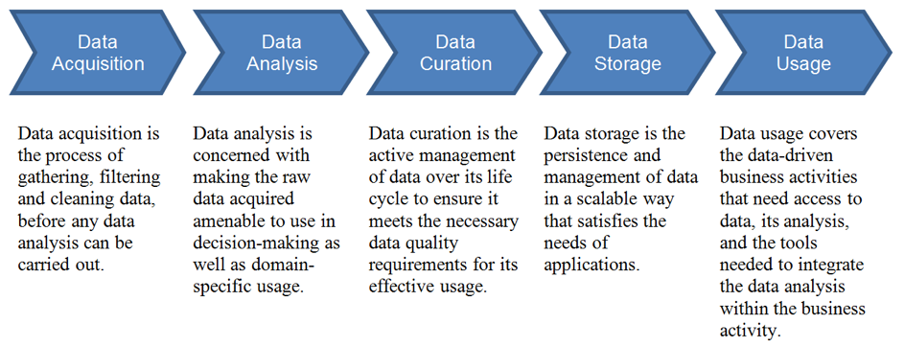
Schematic 2

Slide 7
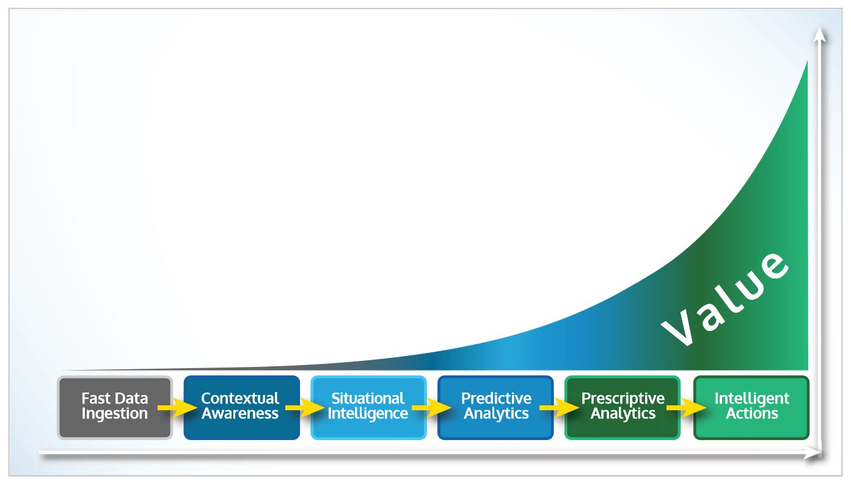
Schematic 3

Slide 8
Ingesting data at speed and volume
Contextual data to provide a baseline for advanced analytics
Situational data and intelligence
Predictive analytics based on machine learning over historical and situational data.
Next best action to be recommended by prescriptive analytics
Execute the real-time action to capture value

Slide 9
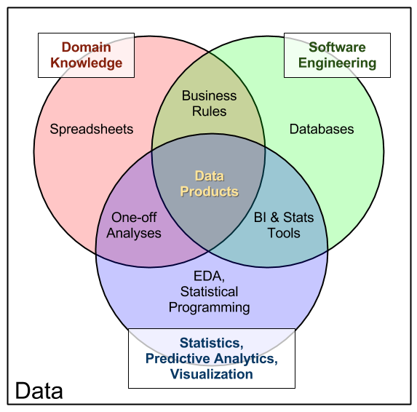

Slide 10
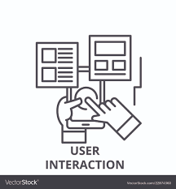
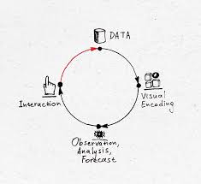
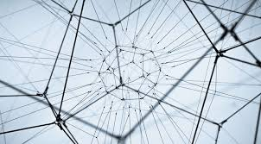
Data Product
User Interaction
Data Interaction
Complexity

Slide 11
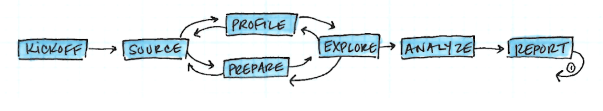
DATA PROJECT FLOW
Kickoff
Start a new project with a question, problem, or dataset
Source
Gather data sources, documentation, research, and team
Profile
Define the data’s shape, features, and any limitations
Prepare
Clean, munge, and wrangle the data into a usable form
Explore
Develop a deeper understanding by querying, visualizing
Analyze
Answer questions and build models in a reproducible way
Deliver
Share output with stakeholders, report discoveries

Slide 12
